Slide 1

opioIDENTITY of America
Simple Linear Regression
Ashira Mawji, Alison Ortiz Dimas, Chae Young Seo

Slide 2
The Opioid Crisis: Defying Gravity
“a public health emergency”
Economic cost of $504 billion in a year (2015)
42,249 deaths from opioid-related overdoses (2016-17)
2.1 million people with opioid use disorders (2016-17)

Slide 3
Game Plan: Operation Overlooked
Identify overlooked variables
Evaluate their relationship with the opioid crisis
Analyze their effect on specific subpopulations

Slide 4
Step 1: Identify overlooked explanatory variables
Political party in power (# of Democrats/Republicans in the state-level House of Representative)
Altitude (feet)
Minimum wage (USD)
Veterans: total (count), disabled (%), unemployed (%), impoverished (%)
Veterinarians (count)
Hospitalizations & ER
Military Compensation & Pension
Place of Death
Primary Insurance Payer
Education
Abundance of Treatment Resources
Crime Rates

Slide 5
Step 2: Evaluate their potential influence on the opioid crisis
Democratic/Republican Ratio → political party in power in states influences policies on healthcare
Altitude → respiratory depression (direct cause of opioid-related deaths)
Minimum wage → ability to purchase opioids
Veterans: total, disabled, unemployed, impoverished → source of prescription opioids
Veterinarians → source of synthetic opioids (fentanyl)

Slide 6
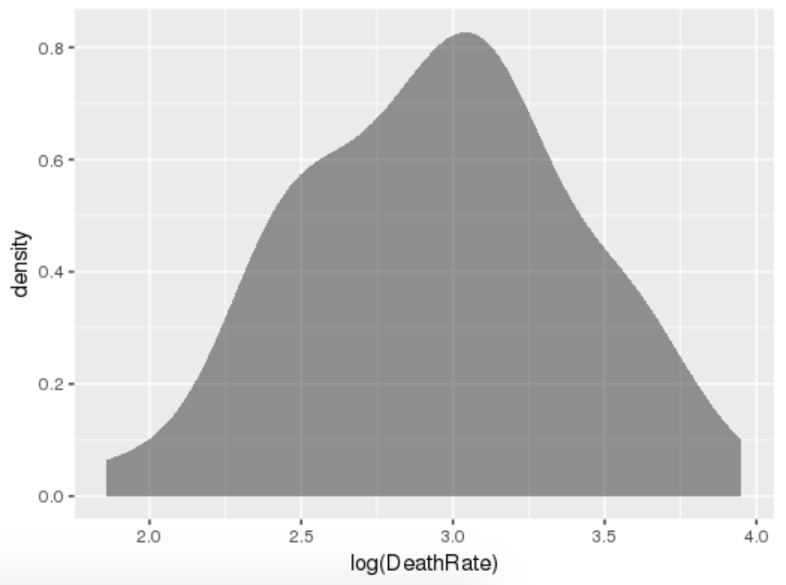
Univariate Analysis of Our Variables
Overdose death rate → log(Death Rate)
Political party in power
Democrats → sqrt(DemRatio)
Republicans
Altitude → log(Altitude)
Veterans
Total (count) → log(VeteranPopu)
Disabled (%)
Impoverished (%)
Bimodal, and therefore excluded: Minimum Wage, Veterinarians

Slide 7
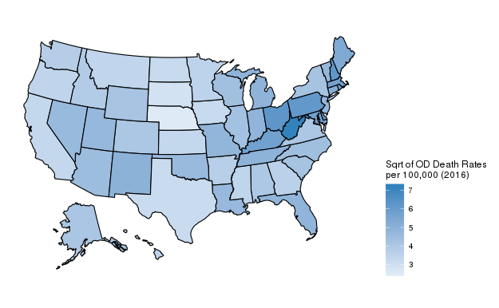
Step 3: Analyze their effect on the opioid crisis by state
Correlation with:
Total overdose death rate (per 100,000 deaths)
Opioid-related overdose death rate (per 100,000 deaths)
Heroin-related overdose death rate (per 100,000 deaths)
Synthetic opioid-related death rate (per 100,000 deaths)
Opioid prescription rate (per 100 people)

Slide 8
Step 3: Analyze their effect on the opioid crisis by state
Visualize associations with scatter plots
Examine correlation values
Create simple linear regression
Remove outliers
Test for significance using bootstrapping

Slide 9
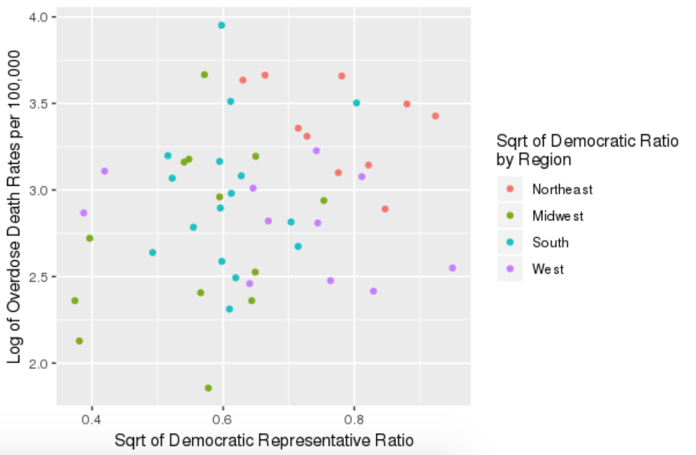
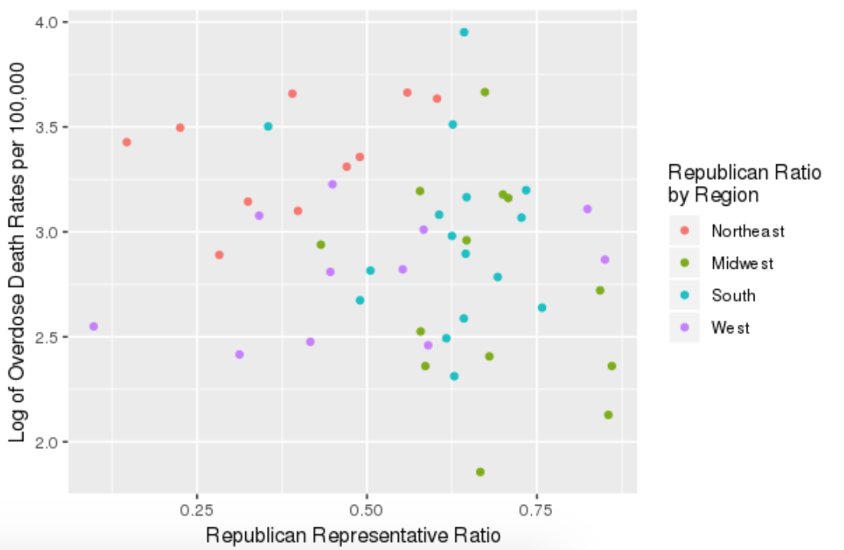
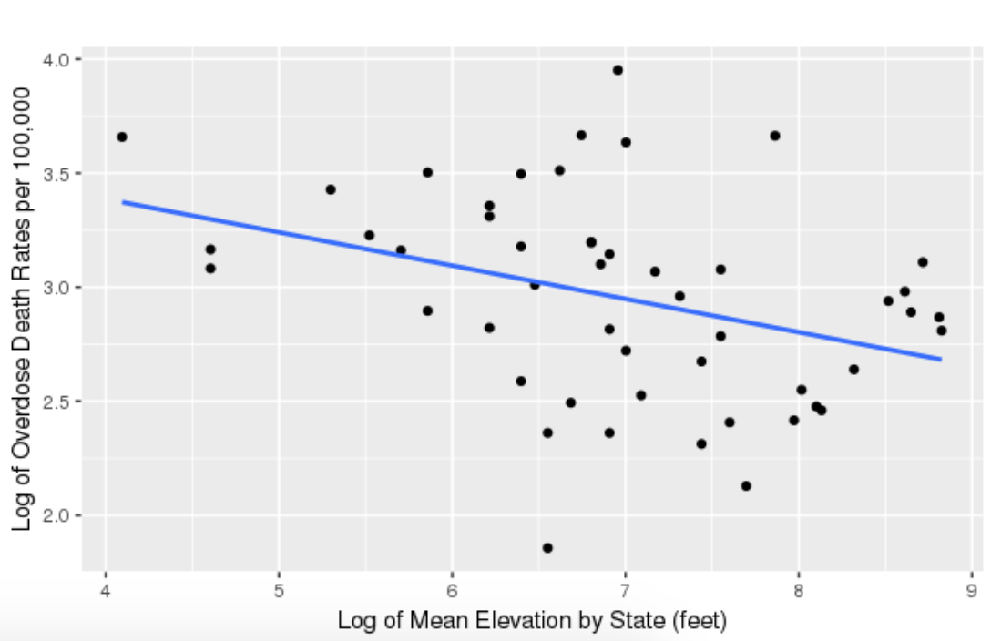
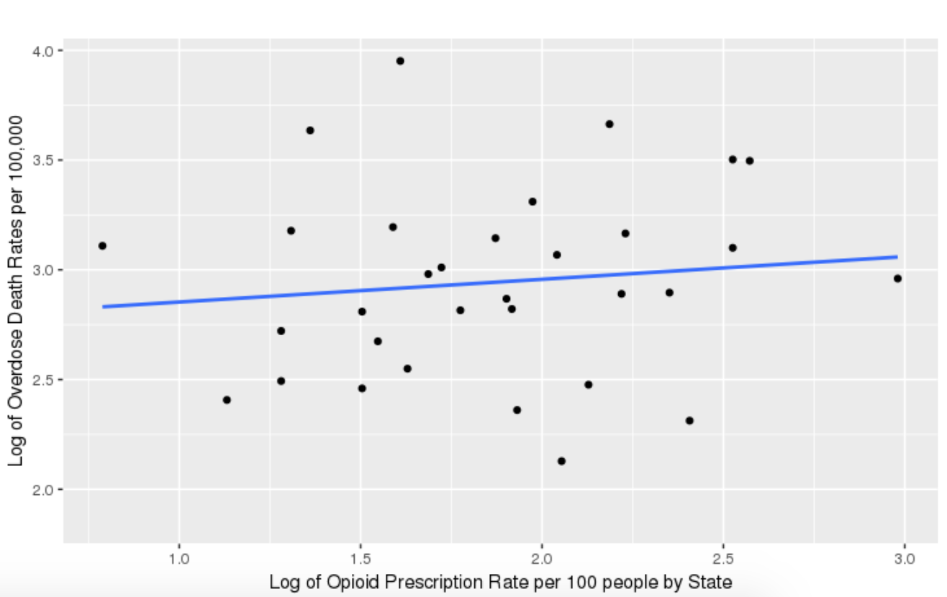
CORRELATION (R) | sqrt.Democrats (Proportion) | Republicans (Proportion) | log.Altitude | log.Opioid Rx Rate
Log(Opioid-Related Deaths) | 0.2322226 | -0.211807 | -0.3569911 | 0.1162814

Slide 10
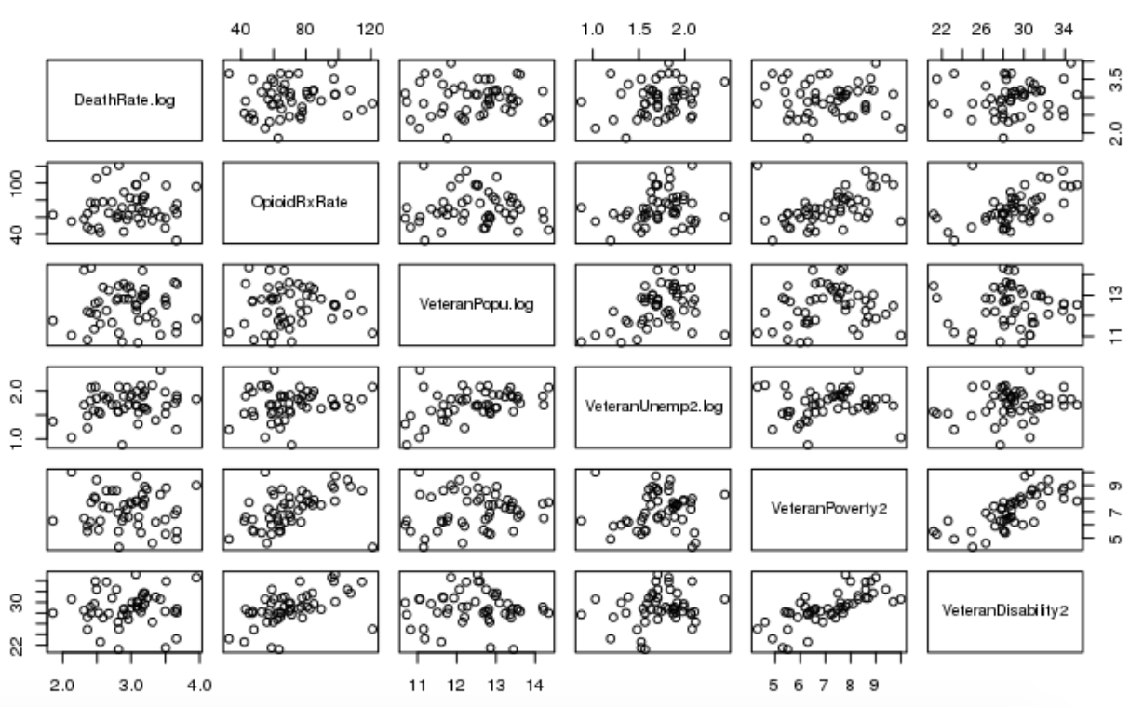
CORRELATION (R) | log.Total Veterans | log.Unemployed Veterans (%) | Impoverished Veterans (%) | Disabled Veterans (%)
Log(Opioid-Related Deaths) | 0.04410374 | 0.2322802 | -0.05005902 | 0.08607311
Notes:
Decided to exclude the 4 outliers with VeteranDisability rates of less than 0.24 but the bootstrap interval still included positive and negative values so was still not meaningful.

Slide 11
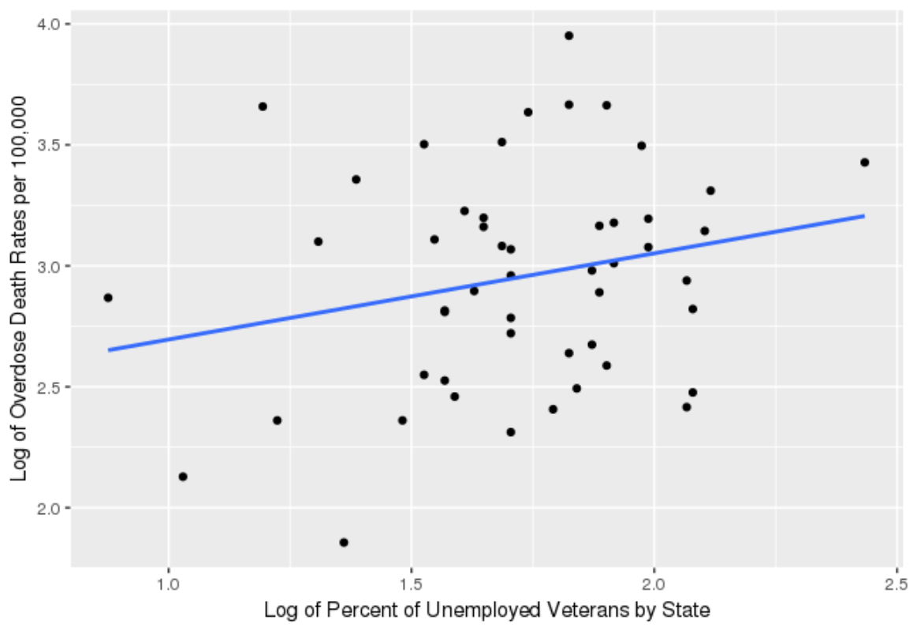
Simple Linear Regression
logDeathRate = 2.3393 + 0.3562(logVeteranUnemp)
Intercept: p-value = 1.15e-07
Slope coefficient: p-value = 0.105
Correlation = 0.232
Bootstrap Interval (-0.075, 0.4983)
Exclude outliers
Correlation = 0.081
Bootstrap Interval (-0.225, 0.380)
Limitations
Very small sample size (n=50)
Predicting human behavior
Notes:
Possibly alleviate the opioid crisis in the long-term by conducting detailed research on and monitoring of veterans using prescription opioids.

Slide 12
Informed Recommendations
1. Collect more data on number of veterans suffering from the misuse of and addiction to opioids.
INFORMATION
2. Conduct greater research on opioid and veteran statistics in order to efficiently allocate their resources in a more informed manner.
KNOWLEDGE
POWER
3. Focus resources (treatments, rehabilitation) on veterans to mitigate and hopefully resolve the crisis.
Notes:
Possibly alleviate the opioid crisis in the long-term by conducting detailed research on and monitoring of veterans using prescription opioids.

